Slide 1
Intergenerational Workplaces: Four Generations

Slide 2
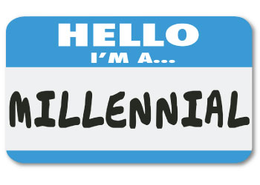
Let’s Get to Know Each Other
Theresa Balsiger, PHR
Executive Search Consultant
Certified in Hogan Assessments
Board Member, and Volunteer
Old Millennial and Mom of 3 boys
Notes:
I won’t ask you to identify your generational grouping!
Your backgrounds –
Social Services?
Environmental?
Lead a team?
Work with other generations at your organization?

Slide 3
Purpose of Generational Analysis
Stereotyping
Develop Understanding
& Strategy For Working Together
Forecast For the Future
Generalizing
"Generational analysis has a long and distinguished place in social science…but we also know this is not an exact science. We are mindful that there are as many differences in attitudes, values, behaviors, and lifestyles within a generation as there are between generations. But we believe this reality does not diminish the value of generational analysis; it merely adds to its richness and complexity.”
-Pew Research Center
Making Assumptions
Notes:
This is simply one tool, alongside personality assessments, team building activities, etc.
It’s about understanding your team/work group/office culture.

Slide 4
Generation Breakdown
80+
71-79
52-70
40-51
23-39
22
or younger
Notes:
Generations are developed not by specific years (no official demarcation), but rather substantial cultural highlights and world events.
For purposes of forecasting and workforce development, we’ll focus on Baby Boomers through Generation Z.

Slide 5
Baby Boomers
74.9 million (recently surpassed as the largest generation by Millennials)
US Births following World War II
Leading spending/buying power and peak consumerism (buy now, pay later)
World Events: Assassinations of JFK and Martin Luther King, Jr., Walk on the Moon, Cuban Missile Crisis, Civil Rights
Cultural Highlights: TV, Rock ‘n Roll, Howdy Doody, Gilligan’s Island, Ed Sullivan Show, Happy Days, Mickey Mouse Club, Hippies, Free Love
Famous Boomers: Oprah, Bruce Springsteen, Madonna, George Clooney, Charles Barkley, Johnny Depp, Bill Clinton
52-70
Notes:
Most think of them as largest population, but they’ve actually been passed by Millenials!

Slide 6
Generation X
55 million, sandwiched between two largest generational groups
Latch-key Kids, MTV Generation
Divorce rates doubled in the mid-1960s, before peaking in 1980
World Events: Computers, Crack Epidemic, Fall of Berlin Wall, Watergate, Operation Desert Storm, Roe v. Wade, Birth Control
Cultural Highlights: Music Videos, Grunge, Hip Hop, Jean Jackets, Saturday Morning Cartoons, Flannel, Big Hair, Microwaves, VCRs, Atari, Nintendo
Famous Xers: Will Smith, Jennifer Aniston, David Beckham, Tiger Woods, Mia Hamm, Ice Cube
40-51

Slide 7
Millennials
75.4 million (recently surpassed Boomers as the largest generation)
Those nearing adulthood by year 2000
Civic-Minded versus Me-Generation
World Events: Columbine, 9/11, Legalization of Marijuana, Same-sex Marriage, Great Recession as young adults
Cultural Highlights: Internet, Instant Messaging, Facebook, Twitter, Cell Phones, Google, Email, Saved by the Bell, Full House
Famous Millennials: Mark Zuckerberg, Kardashians, Beyoncé, Prince Harry, Michael Phelps, LeBron James
23-39
Notes:
Narcissistic, Entitled, Collaborative
Great Recession leading to Boomerang Generation or Peter Pan Generation

Slide 8
Millennials
Notes:
Current “young professionals”

Slide 9
Generation Z
The largest generation, and next generation dominating the workforce
Most racially diverse
Projected to be the most risk-averse
World Events: Terrorism, Great Recession as children
Cultural Highlights: 24/7 news, Snapchat, 5 Screen Generation (smartphone, desktop, laptop, tablet and TV), Emojis, YouTube
Famous Zs: Malala Yousafzai, Smosh, Ryan Higa, KSI
Already changing the future of education, and therefore the workforce
22
or younger
Notes:
Persistent, driven, realists
Malala Yousafzai (shot by Taliban at 14 and now an human rights advocate)

Slide 10
Generation Z
Logan LaPlante
https://www.youtube.com/watch?v=h11u3vtcpaY

Slide 11
Current Workforce
- 2013 US Bureau of Labor Statistics

Slide 12
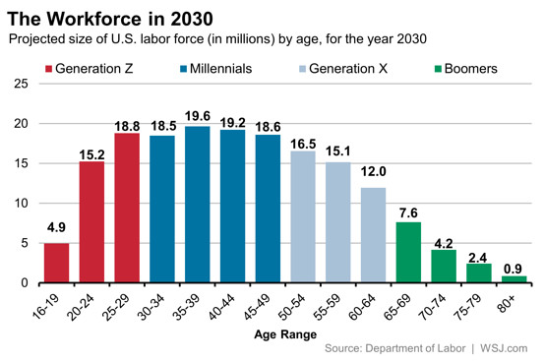
Workforce Projections
“Generations follow observable historical patterns and thus offer a very powerful tool for predicting future trends. To anticipate what 40-year-olds will be like 20 years from now, don’t look at today’s 40-year-olds; look at today’s 20-year-olds.”
-Neil Howe and William Strauss, Harvard Business Review

Slide 13
Impacts in the Workplace
Technology
Workplace Culture
Leadership of the next Generations

Slide 14
Evolution of Technology

Slide 15
Evolution of Technology

Slide 16
Evolution of Technology
Technology Considerations
BYOD Policies
Employee Accessibility
Job Application Processes
Notes:
Impacts every aspect of what we do externally…but what about internal considerations?

Slide 17
Workplace Culture
Notes:
Policies needing modifications

Slide 18
Workplace Culture
Communications
Don’t Assume
Discuss Expectations
Customize
Notes:
Realtor Example
Donors likely all want to be communicated with in different ways, just like employees

Slide 19
Leadership
DO
Experiment with mixed-age teams and reverse mentoring programs that enable older, experienced workers to interact with and learn from younger hires
Develop incentive plans that reflect where your employees are in their lives
Conduct regular human resources surveys to get a pulse on your employees’ demographics and needs
DON’T
Bother with generation-based employee affinity groups — they generally reinforce stereotypes
Act like a top-down manager — forge partnerships with employees of different ages and encourage them to share their opinions
Assume you already know how to motivate employees who are older or younger — ask them what they want out of their professional lives
-Rebecca Knight, Harvard Business Review
Notes:
New leadership approaches for the next generation
In the Don’t – mention Googles recent class action lawsuit (Google interviews for four different jobs she was qualified for between 2007 and 2014. Fillekes didn't get any of them and said it was due to her age. She also claimed that a recruiter asked her to provide graduation dates on her resume as a way to determine her age, according to court records.) While hiring younger people seems a logical move due to the typical skillsets needed, the issue should be qualifications, not age.

Slide 20
Leadership
Proper Training for
Mid-Level Managers
Expertise Retention
Total Rewards and Other Retention Tools
Notes:
Individual Contributors may not have the skill sets to be strong leaders.
Development flex work arrangements to retain the expertise of those retiring.

Slide 21
Additional Resources
Five Generations - https://hbr.org/2014/09/managing-people-from-5-generations
Millennials - http://www.pewresearch.org/fact-tank/2016/04/25/millennials-overtake-baby-boomers/
Generation Z - http://www.huffingtonpost.com/daniel-burrus/gen-z-will-change-your-wo_b_9150214.html
Pew Research Center - http://www.pewresearch.org/topics/generations-and-age/
Harvard Business Review - https://hbr.org/2007/07/the-next-20-years-how-customer-and-workforce-attitudes-will-evolve
“The 2020 Workplace: How Innovative Companies Attract, Develop, and Keep Tomorrow's Employees” by Jeanne Meister & Karie Willyerd

Slide 22
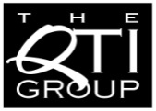
Stay in Touch
The QTI Group is the talent expert
who understands, advises and connects,
so that its customers
can adapt, grow and succeed.
For more information regarding the topics you learned about today, please contact:
We’ve got a talent for business.®
Theresa Balsiger, PHR
Executive Search Consultant
QTI Executive & Professional Search, Inc.
702 E Washington Ave • PO Box 552
Madison, WI 53701-0552
608-232-2650
theresa.balsiger@qtigroup.com
www.qtigroup.com

