Slide 1
Attract, Retain, Develop & Engage The Best Talent
Madison Non-Profit Day Conference
October 2, 2014
Presented by Matt Shefchik and Theresa Balsiger

Slide 2
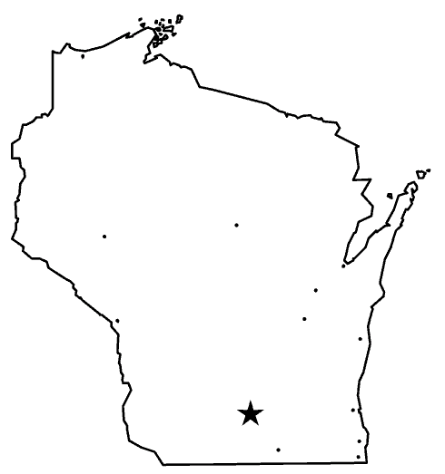
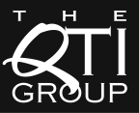
QTI Group Overview
The QTI Group has been an active member of the business community since 1957. Our key service areas of staffing, recruiting, HR Consulting, and HR Partnerships help businesses compete, gain ground, lead, and succeed.
Staffing
Focus on industrial, skilled,
and administrative needs,
from temporary help
to contract-to-hire
Recruiting
Professional and executive
recruitment practice
HR Partnerships
Offering HR/Payroll/Benefits
services, HR assistance,
HR investigations,
HR assessments, and HR workshops
HR Consulting
Compensation administration,
variable and incentive plans,
employee engagement surveys,
and succession planning

Slide 3
Your Talent
In five years (2019), who are your organization’s top leaders/employees? How are these positions or people different from today?
What are you doing to develop these future leaders?
How do you find & attract talent today to fill critical positions?
How do you invest in making your culture have an competitive advantage?
What are your biggest talent challenges in 2014?

Slide 4
Talent Trends in the Non-profit Industry
Non-profit organizations are hiring again!
10.7 million employed by the nonprofit sector – 3rd largest US industry behind retail and manufacturing
Job growth is prevalent amongst all subsectors (health, arts/culture, human services, environmental, etc.)
Only 15% of non-profit organizations have a recruitment budget
2013 turnover rate was 16%
Inability to pay competitively (32%)
Inability to promote top talent (19%)
Excessive workloads (16%)
nonprofitHR 2014 Employment Practices Survey

Slide 5
QTI 2014 Talent Planning Survey Talent Challenges in 2014
Respondents included for-profit and non-profit organizations in Wisconsin across a wide spectrum of industries and sizes.
Respondents view the following as “significant” to “moderate” challenges in 2014:
Attracting the right talent (80%)
Improving leadership development and succession planning (78%)
Preparing for healthcare reform (PPACA) (67%)
Enhancing employee engagement (67%)
Improving performance management (66%)
Retaining the right talent (58%)

Slide 6
Finding, Attracting and Hiring Talent Quantity
Bureau of Labor Statistics, OEA

Slide 7
Finding, Attracting and Hiring Talent Quantity

Slide 8
Finding, Attracting and Hiring Talent Quality

Slide 9
Finding, Attracting and Hiring Talent Quality
Tomorrow’s Jobs will Require Increased skills
Source: ACS for Today’s skills; Moody’s Analytics for tomorrow’s Demand

Slide 10
Finding, Attracting and Hiring Talent Method
Post and pray recruiting strategies no longer work
Average number of applications a recruiter receives for a given job posting increased by 167% from 2007.
100-300 names to produce one hire for a key position
880 online visitors to yield one hire
Quality of many applicant pools is poor (35 percent of the typical applicant pool does not meet even the most basic job requirements)
Success comes from multi-source posting and proactive outreach
Propriety talent networks, aggregator sites, organization sites, referrals
Good News & Bad News: Passive candidates are more open to a conversation
21% of full-time employees plan to change jobs in 2014, up from 17% last year – highest percentage in post-recession era
45% “I’m happy with my job and not looking for another, but would be open to other opportunities.”

Slide 11
Finding, Attracting and Hiring Talent Method
CEB active-passive index
Tracks job search activity among workers going back to 2006
Passive candidate pool is larger than it has been in the past 5 years
Over 50% in the passive category compared to 22% in 2006
The new normal for employment is just under five years

Slide 12
Recruitment & Selection Process
 | Poor Practices | Best Practices
Anticipate the Need | Hiring only when you have an opening Having ad hoc succession plan Overlooking the skills your organization will need in the future Indulging in irrational optimism about attrition, succession depth, and recruiting yields | Conducting ongoing, proactive analysis of future needs Continually evaluating the pool of potential talent Developing rigorous periodic forecasts of the company’s talent needs
Specify the Job | Relying on generic competency models Looking primarily for charisma, general ability and track record | Defining the specific demands of the job Specifying which skills and experience are relevant Identifying the team the candidate will need to work with Considering how company culture and context affect the role

Slide 13
Recruitment & Selection Process
 | Poor Practices | Best Practices
Develop the Pool | Taking a scattershot, ad hoc approach to finding candidates Limiting the pool Looking for only external or internal candidates | Developing a larger pool Considering people on the periphery of the organization (employees in remote offices, consultants, suppliers, customers) Tapping your networks and involving the right external partners
Assess the Candidates | Settling on the first adequate choice Looking endlessly for the perfect choice Using the wrong interviewers Overly bureaucratic Unstructured or generic interviews Conducting inadequate (or no) reference checks | Using a small number of high-caliber, well-trained interviewers Employing behavior based interviews Conducting detailed reference checks

Slide 14
Recruitment & Selection Process
 | Poor Practices | Best Practices
Close the Deal | Assuming money is everything Discussing only the positives of the job | Demonstrating accurate support for the candidates interests Describing the job realistically Involving the hiring manager personally, not just HR in closing the deal
Integrate the Newcomer | Assuming the new hire is “plug and play” Providing inadequate support and mentoring | Using veteran top performers as mentors Making sure the newcomer checks in regularly with the boss, mentor and HR, even when no problems exist
Audit and Review | Hanging on to bad hires Failing to review hiring practices and institutionalize the best ones | Removing bad hires immediately Regularly reviewing recruiting practices Holding all assessors accountable for the quality of their evaluations

Slide 15
Workforce & Succession Planning
1. Strategic Plan Leads the Way
2. Know What Talent You Need
3. Know What Talent You Have
4. Do The Work – Succession & Development Strategies
5. Recruit To Fill The Talent Gaps
6. Monitor, Evaluate, Improve
Workforce & Succession Planning
Retirements - next 5 yrs.
Talent for new strategies
Anticipated turnover
Proactive Sourcing
Talent Pipelining
Create & Execute Development Plans
Communicate
9 Box Performance & Potential Grid
Source: Adopted from U.S. OPM Succession Planning Process

Slide 16
Retention & Engagement Best Practices Without significant ability, aspiration and engagement, employees will not excel in their next jobs.
Aspiration
Engagement
Ability
The High-Potential Employee
A high-potential employee is someone with the ability, engagement and aspiration to rise to and succeed in more senior critical positions. It takes both interpersonal and technical skills.
*Source: CEB

Slide 17
Retention and Engagement Best Practices
How do you create the culture where employees develop ability, give discretionary effort (engage) and aspire for more?
Vision
Voice
More/Better Work
Training & Development
Recognition
Flexibility
Community at Work

Slide 18
Extrinsic and Intrinsic Incentive Rewards
Individual motivation is linked to the availability of a system of extrinsic and intrinsic rewards
Extrinsic Rewards
Originates from outside the individual
Intrinsic Rewards
Originates from inside the individual

Slide 19
Intrinsic Rewards
Factors increasing intrinsic motivation
Challenge
Curiosity
Recognition
People are more motivated when they pursue goals that have personal meaning, that relate to their self-esteem, when performance feedback is available, and when attaining the goal is possible but not necessarily certain.
Internal motivation is increased when something in the physical environment grabs the individual’s attention (sensory curiosity) and when something about the activity stimulates the person to want to learn more (cognitive curiosity).
Control
People want control over themselves and their environments and want to determine what they pursue.
Cooperation & Competition
Intrinsic motivation can be increased in situations where people gain satisfaction from helping others and also in cases where they are able to compare their own performance favorably to that of others.
People enjoy having their accomplishment recognized by others, which can increase internal motivation.

Slide 20
Finding, Attracting and Hiring Talent What Motivates Passive, Fully Engaged Employees?
What motivates candidates that are either passive or active that are NOT fully engaged?
Culture
Alignment
Their Boss
¹Source: Novo Group

Slide 21
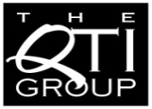
Thank You
We’ve got a talent for business.®
Theresa Balsiger, PHR
Executive Search Consultant
QTI Professional Staffing, Inc.
702 E Washington Ave • PO Box 552
Madison, WI 53701-0552
608-663-4801
theresa.balsiger@qtigroup.com
www.qtigroup.com
We’ve got a talent for business.®
Matt Shefchik
Chief Operating Officer
QTI Consulting, Inc.
702 E Washington Ave • PO Box 552
Madison, WI 53701-0552
608-663-4801
matt.shefchik@qtigroup.com
www.qtigroup.com
The QTI Group is the talent expert
who understands, advises and connects,
so that its customers
can adapt, grow and succeed.

Slide 22
The QTI Group is the talent expert
who understands, advises and connects,
so that its customers
can adapt, grow and succeed.

