Slide 1
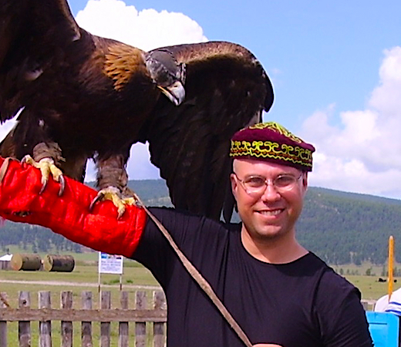
Google Ad Grants
What to do with $120,000/year from the Google for Nonprofits Program
Part 1. Green Lake Conference Center’s journey and lessons learned
Part 2. Small group work: Crafting an ad for your nonprofit (Google Haiku)
Part 3. Wisdom of the group: your favorite resources & tips for nonprofits

Slide 2
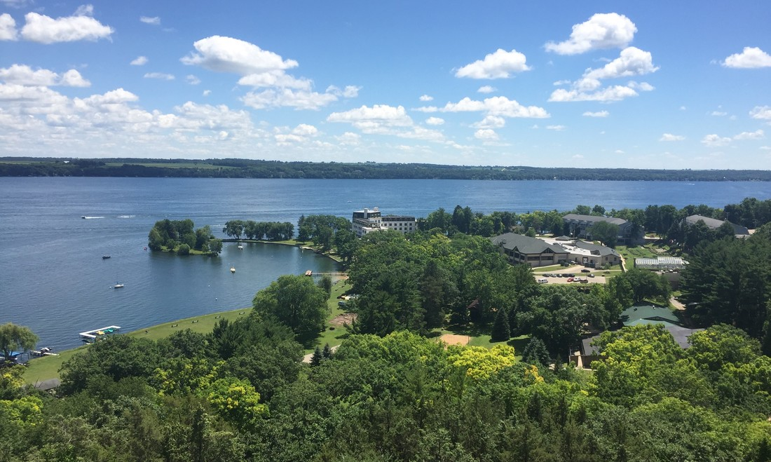

Slide 3
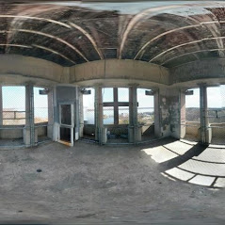
CLOSED FOR BUSINESS?
Additional Challenges for GLCC:
Name recognition
How to differentiate?
Marketing budget
Notes:
GLCC, when I was hired, was listed as closed for business on Google, and this was the cover photo/image for our property. What?!?

Slide 4
Google My Business Program
https://www.google.com/business
Eligibility: all businesses and organizations, including nonprofits
Cost: free
Website requirements: complements your existing website.
If you don’t have a website, Google My Business can auto-generate one
Process: set up a business profile (location, hours, description, etc.)
Verification: takes around two weeks to receive a postcard
Value: you appear in search results across Google / Google Maps / Google+
GLCC results: 30,000 views & 600 website visits per month
Admission: we are not capturing those visitors through an opt-in

Slide 5
Google for Nonprofits (& the Ad Grants) Program
https://www.google.com/nonprofits/
Eligibility: nonprofit charitable organizations that are
1. not a governmental entity or organization
2. not a hospital or healthcare organization
3. not a school, academic institution, or university
if #3 describes you, check out Google for Education
Process: applying takes 5-10 minutes
Approval: 2-3 weeks
Value of Ad Grants: $10,000/month of in-kind advertising
GLCC results: 177 click-throughs last month
majority of new business finds us through Google

Slide 6
Let’s create a Google Ad together, 1st try
Format:
30 characters for headline 1 “|” 30 characters for headline 2
80 characters for a short description and call to action (CTA)
Green Lake Conference Center (GLCC) example:
Central WI Conference Center | Serving Nonprofits & Schools
Looking for an immersive experience and planning assistance? Call us today.

Slide 8
Google Ads vs Google Ads Express GLCC uses Express
Google Ads, the positives:
Can set up campaigns, access more analytics, more tools & control
Google Ads, the challenges:
How much data is too much data?
Time requirements (5+ hours/week just to start)
Required to maintain a high click-through rate: choose your geographic reach wisely, research keywords, and write compelling Google haiku
Google Ads Express, the positives:
Time requirements (15 minutes a week)
You can go global
Google Ads Express, the challenges:
Not as much control & fewer tools
Less analytics

Slide 9
Managing your Google Ads
Determine:
Google Ads versus Google Ads Express
Who are you trying to reach: donors, new members/clients, volunteers, voters?
Where do they live: local, statewide, regional, national, global?
What are you providing/doing that they care care about?
How are you different from organizations working on the same #s 2-4 as you?
How to capture the new visitors to your website: newsletter opt in, offers, other?
Tips for avoiding a suspended account or ad:
Check your ad account regularly
Use the domain listed in your Google My Business account (but…)
Use a phone number appearing on your website
Beware of using Trade Marked terms (but…)
Include a sequential number before your Ad name
Google does not like exclamation points!!! Or #1

Slide 10
Let’s create a Google Ad together, 2nd try
Including goals and geographic reach this time around.
Format:
30 characters for Headline 1 “|” 30 characters for headline 2
80 characters for a short description and call to action (CTA)
GLCC example:
Let’s walk through one together online: GLCC My Business

Slide 11
Wisdom of the group!
Please share:
your first name and your email
your favorite free/affordable resources and tips for nonprofits
Anybody using the other Google for Nonprofits resources?
I will compile everyone’s suggestions and get them out to you.
Thank you for your time!

